Slide 1
N-Gram
By: Muhammad Javed

Slide 2
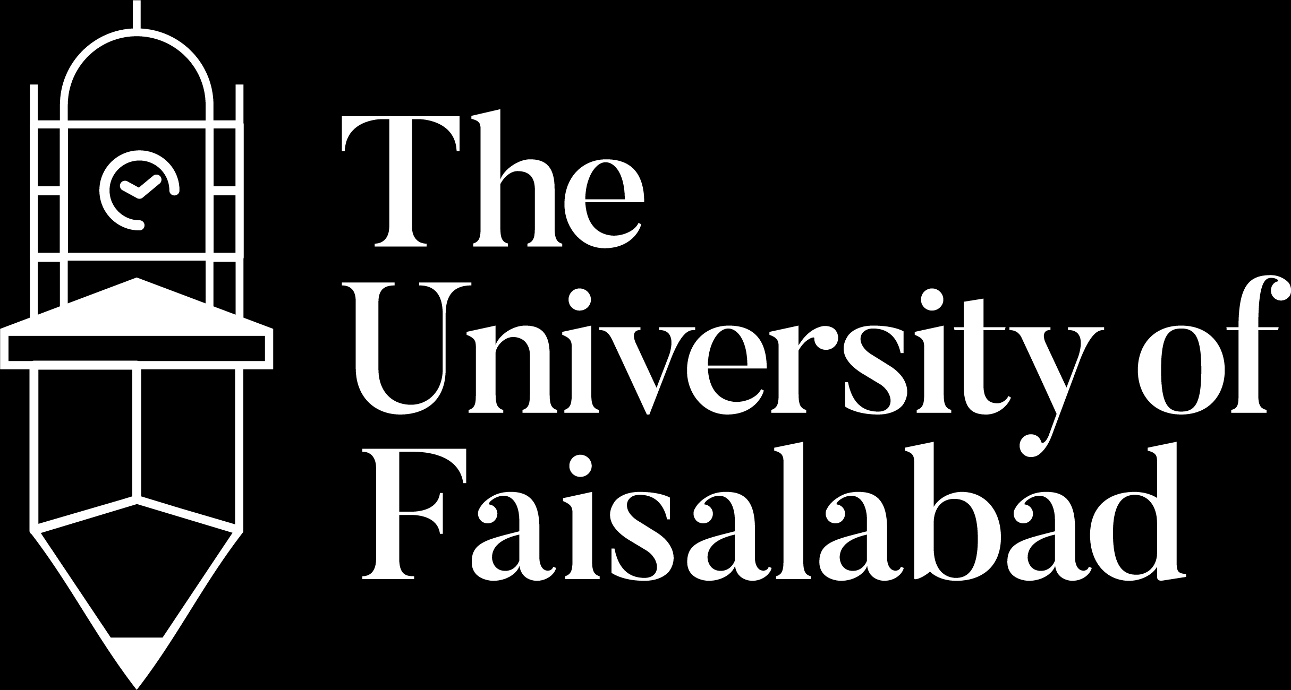

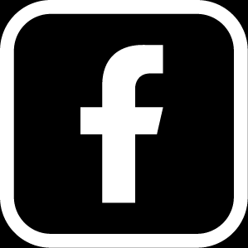

www.tuf.edu.pk
unioffaisalabad
Introduction of N-Grams:
“Predicting words seems somewhat less fraught”
We formalize this idea of word prediction with probabilistic models called
N-gram models, which predict the next word from the previous N −1 words.
Example:
Finding the probability of occurrence of word “been” in following the sentence “I have….”
Please turn your homework ….
- Hopefully, most of you concluded that a very likely word is “in” or possibly “over” but probably not “the”.

Slide 3

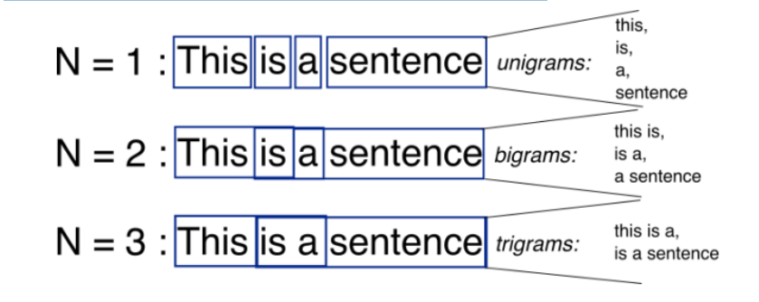
N-Gram
www.tuf.edu.pk
unioffaisalabad
An N-grams is an N-token sequence of words:
- a 2-gram (more commonly called a bigram) is a two-word sequence of
words like “please turn”, “turn your” or “your homework”.
- a 3-gram (more commonly called a trigram) is a three-word sequence of
words like “please turn your”, or “turn your homework”.

Slide 4
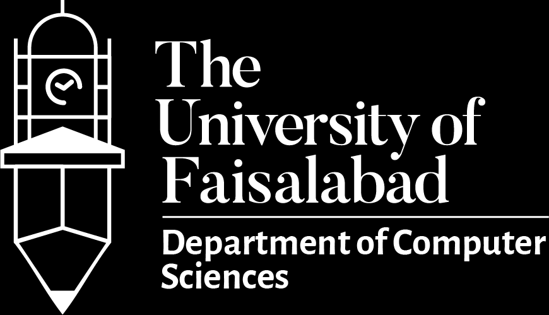
www.tuf.edu.pk
unioffaisalabad
Continue:
Such statistical models of word sequences are also called language models or LMs.
- computing the probability of the next word turns out to be closely related to computing the probability of a sequence of words.
For Example;
the following sentence, has a non-zero probability of appearing a text as;
✓ non-zero probability:
“ …. all of a sudden I notice three guys standing on the sidewalk…”
✓ Lower probability:
- while the same set of words in a different order has a much lower probability;
“ …. on guys all I notice sidewalk three a sudden standing the…”

Slide 5
www.tuf.edu.pk
unioffaisalabad
Applications:
Estimators like N-grams that assign a conditional probability to possible next words can be used to assign a joint probability to an entire sentence.
N-grams are essential in any task in which we have to identify words in noisy, ambiguous input.
In speech recognition, for example, the input speech sounds are very confusable and many words sound extremely similar. e.g., in the movie “take the Money and Run”;
e.g., - “I have a gun” is far more probable than
- the non-word “I have a gub” or even “I have a gull”.
N-grams are essential In machine translation, suppose we are translating a Chinese source sentence into English translations ;
e.g., - “he briefed to reporters on the chief contents of the statement”.
- “he briefed to reporters on the main contents of the statement”.
- “he briefed reporters on the main contents of the statement”.
=> An N-gram grammar might tell us that, brief reporters is more likely than briefed
to reporters, and main contents is more likely than chief contents.

Slide 6
www.tuf.edu.pk
unioffaisalabad
Continue:
In spelling correction, we need to find and correct spelling errors like the following that accidentally result in real English words:
e.g., - “They are leaving in about fifteen minuets to go to her house.”
NOTE: Since these errors have real words, we can’t find them by just flagging words that aren’t in the dictionary.
Therefore, “in about fifteen minuets” is a much less probable sequence than “in about fifteen minutes”.
A spellchecker can use a probability estimator to both factors as;
- detect these errors and
- to suggest higher-probability corrections.
N-grams are also crucial in NLP tasks like;
Part-of speech tagging:
- In determining the role of word as a noun or verb and etc. in sentencegiven the previous words
e.g., - This is a Screw(Noun).
- Please Screw(Verb) this nut.
Natural language generation:
- Predicting the next word in sentence.
e.g., - This has to…..
Word similarity:
- Finding similarity between words.
e.g., - minutes and minuet.
as well as in applications from authorship identification and sentiment extraction to predictive text input systems for cell phones

Slide 7
www.tuf.edu.pk
unioffaisalabad
Counting Words in Corpora
Probabilities are based on counting things.
Counting of things in natural language is based on a corpus (plural corpora), an on-line collection of text Corpus or speech.
Vocabulary size (the number of types) grows with at least the square root of the number of tokens (i.e. V > O(√N).
Two popular corpora (1) Brown corpus, (2) Switchboard corpus.
(1) Brown corpus : It has 61,805 wordform type.
(2) Switchboard corpus: It has 20,000 wordform type.

Slide 8
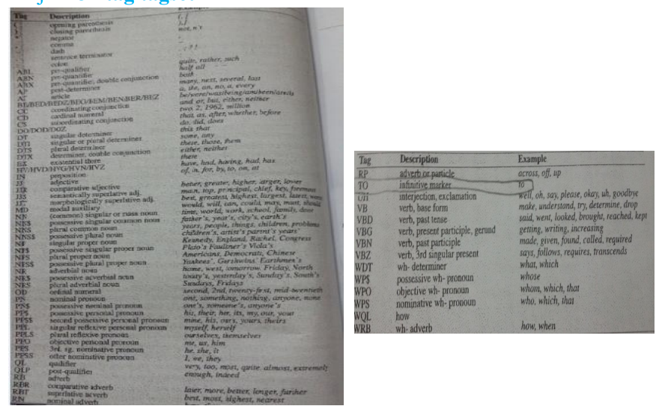
www.tuf.edu.pk
unioffaisalabad
Brown corpus : It has 61,805 wordform type.
- with just 87-tag tagset.

Slide 9
Simple (Unsmoothed) N-grams:
www.tuf.edu.pk
unioffaisalabad
Our goal is
- to compute the probability of a word w
- given some history h, or P(w|h).
Suppose the history h is “its water is so transparent that” and we want to know the probability that the next word is “the”:
P(the|its water is so transparent that).
P(the|its water is so transparent that) = C(its water is so transparent that the)/C(its water is so transparent that)
If we wanted to know the joint probability of an entire sequence of words like its water is so transparent, we could do it by asking “out of all possible sequences of 5 words, how many of them are its water is so transparent?”
We would have to get the count of its water is so transparent, and divide by the sum of the counts of all possible 5 word sequences.
“ That seems rather a lot to estimate”

Slide 10
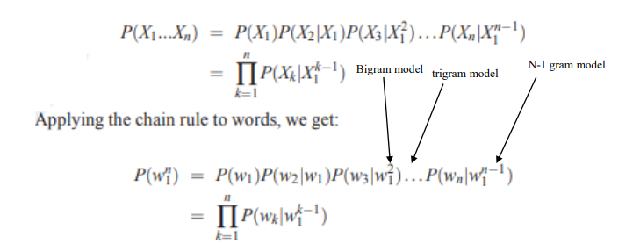
Continue:
www.tuf.edu.pk
unioffaisalabad
For this reason, we represent the probability of a particular random variable;
- Xi taking on the value “the”, or P(Xi = “the”),
- represent a sequence of N words either as P(w1, w2 ,... wn)
How we compute probabilities of entire sequences like P(w1, w2,... wn)?
We can do is to decompose this probability using the chain rule of probability:

Slide 11
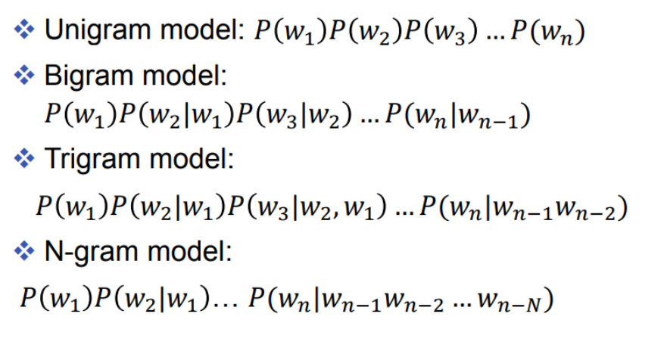
Continue:
www.tuf.edu.pk
unioffaisalabad
N-grams Models

Slide 12





How does Sentiment Analysis work?
www.tuf.edu.pk
unioffaisalabad
The bigram model, for example,
- approximates the probability of a word given all the previous words
by the conditional probability of the preceding word
- In other words, instead of computing the probability;
- we approximate it with the probability;
When we use a bigram model to predict the conditional probability of the next word, we are thus making the following approximations as;
Thus, the general equation for this N-gram approximation to the conditional probability of the next word is a sequence is;

Slide 13
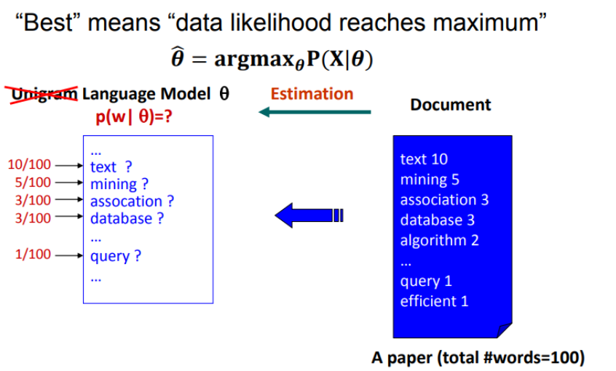
How does Sentiment Analysis work?
www.tuf.edu.pk
unioffaisalabad
Finally, the simplest and most intuitive way to estimate probabilities is called
- Maximum Likelihood Estimation, or MLE.
We get the MLE estimate for the parameters of an N-gram model by taking counts from a corpus, and normalizing them so they lie between 0 and 1.
For Example:-
- Maximum Likelihood Estimation, or MLE.

Slide 14
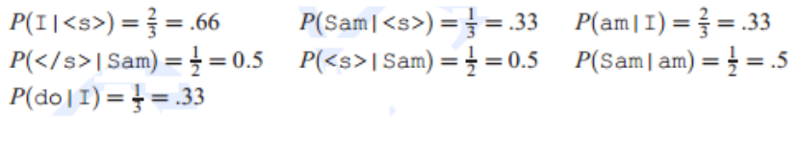
Example:
www.tuf.edu.pk
unioffaisalabad
Let’s work through an example using a mini-corpus of three sentences.
- We’ll first need to augment each sentence with a special symbol <s> at the beginning of the sentence, to give us the bigram context of the first word. We’ll also need a special end-symbol </s>.
<s> I am Sam </s>
<s> Sam I am </s>
<s> I do not like green eggs and ham </s>
Here are the calculations for some of the bigram probabilities from this corpus.

Slide 15
Example2:
www.tuf.edu.pk
unioffaisalabad
Suppose the word Chinese occurs 400 times in a corpus of a million words like the Brown corpus.
What is the probability that a random word selected from some other text of say a million words will be the word Chinese?
The MLE estimate of its probability is 400 / 1000000 = .0004.

Slide 16
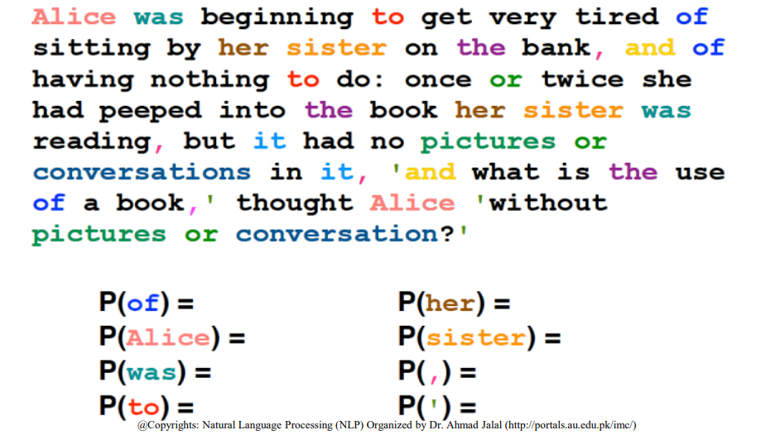
Class Participation
www.tuf.edu.pk
unioffaisalabad
Calculate the simple N-gram probabilities; (a) with white-space , (b) with punctuations

Slide 17
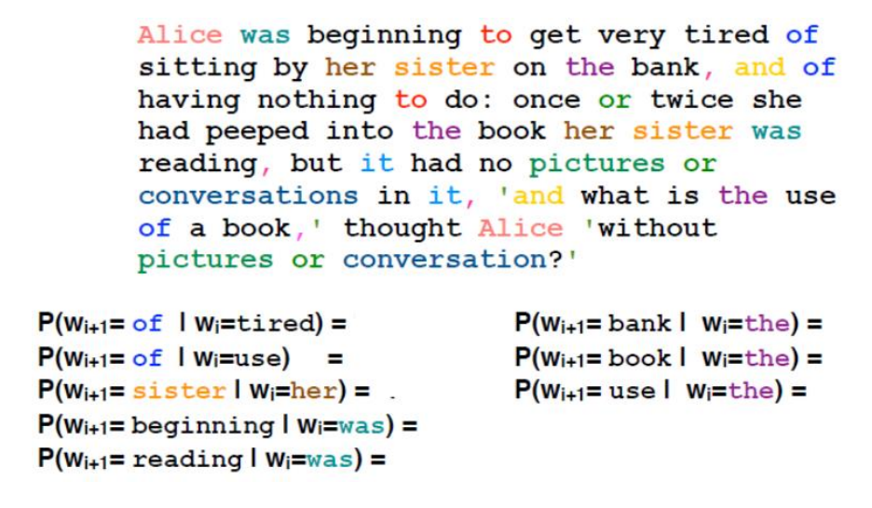
Class Participation:
www.tuf.edu.pk
unioffaisalabad
Calculate the simple N-gram probabilities;

Slide 18
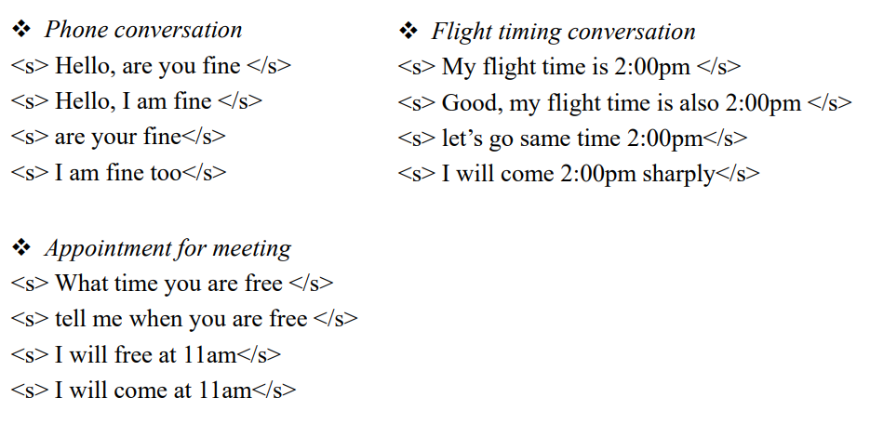
3. Simple (Unsmoothed) N-grams (Class Participation)
www.tuf.edu.pk
unioffaisalabad
Calculate the bigram probabilities using a mini-corpus of following sentences combination;

Slide 19
Training and Test Sets
www.tuf.edu.pk
unioffaisalabad
The probabilities of an N-gram model come from the corpus it is trained on.
The parameters of a statistical model are trained on some set of data (training corpus) , and then;
- we apply the models to some new data in some task (test corpus) (such as speech recognition) and see how well they work.
There is a useful metric for how well a given statistical model matches a test corpus, called perplexity.
- Perplexity is based on computing the probability of each sentence in the test set.
- and model assigns a higher probability to the test set

Slide 20
N-Gram sensitivity to the Training Corpus
www.tuf.edu.pk
unioffaisalabad
N-grams do a better and better job of modeling the training corpus;
- as we increase the value of N (i.e., Uni, bi, Trigram, ….)
We especially wouldn’t choose training and tests from different genres of text like;
- newspaper text, early English fiction, telephone conversations, and web pages.
For Example;
➢ to build N-grams for text prediction in SMS (Short Message Service),
- we need a training corpus of SMS data.
➢ To build N-grams on business meetings,
- we would need to have corpora of transcribed business meetings.

Slide 21
Unknown Words: Open versus closed vocabulary tasks
www.tuf.edu.pk
unioffaisalabad
Closed Vocabulary is the assumption that we have such a lexicon; and
- the test set can only contain words from this lexicon.
- The closed vocabulary task thus assumes there are no unknown words.
We call these unseen events unknown words, or out of vocabulary (OOV) words.
- The percentage of OOV words that appear in the test set is called the OOV rate.
Open Vocabulary system is one where we model these potential unknown words in the test set by adding a pseudo-word called <UNK>.
We can train the probabilities of the unknown word model <UNK> by following ways
Example of open vocabulary;
- Subject used i.e., instead of For example.

Slide 22
Unknown Words: Open versus closed vocabulary tasks (Estimate OOV probability)
www.tuf.edu.pk
unioffaisalabad
Choose a vocabulary (word list) which is fixed in advance.
Convert in the training set any word that is not in this set (any OOV word) to the unknown word token <UNK> in a text normalization step.
Estimate the probabilities for <UNK> from its counts just like any other regular word in the training set.
For Example;
- list of fruits i.e., apple, grapes, …..
- contents of course i.e., regular expression, parsing, ….

Slide 23
Evaluating N-grams: Perplexity
www.tuf.edu.pk
unioffaisalabad
The correct way to evaluate the performance of a language model is;
- to embed it in an application and measure the total performance of the application.
Extrinsic evaluation :-
End-to-end evaluation is called extrinsic evaluation, and also sometimes called in vivo evaluation.
- End-to-end evaluation is often very expensive; evaluating a large speech recognition test set.
- does not guarantee an improvement in speech recognition performance
Intrinsic evaluation :-
An intrinsic evaluation metric is one which measures the quality of a model dependent to specific application.
- given two probabilistic models, that has a tighter fit to the test data or predicts the details of the test data better.

Slide 24
Evaluating N-grams: Perplexity
www.tuf.edu.pk
unioffaisalabad
Any corpus is limited, some perfectly acceptable English word sequences are bound to be missing from it.
- “zero probability N-grams”.
Words that are in our vocabulary (they are not unknown words),
- but appear in a test set in an unseen context (For Example; they appear after a word they never appeared after in training)?.
Due to this problem, the maximum likelihood estimate of the probability for this N-gram will be zero.
This mean, to evaluate our language model,
- we need to modify the MLE method to assign some non-zero probability to any N-gram,
- even one that was never observe in training.
To keep a language model from assigning zero probability to these unseen events, we’ll have;
- to shave off a bit of probability mass from some more frequent events
- and give it to the events we’ve never seen.
This modification is called smoothing or discounting
There are variety of ways to do smoothing:
(a) add-1 smoothing, (b) add-k smoothing,(c) Kneser-Ney smoothing

Slide 25

Evaluating N-grams: Perplexity
www.tuf.edu.pk
unioffaisalabad
One simple way to do smoothing might be just to take our matrix of bigram counts,
- before we normalize them into probabilities, and add one to all the counts.
This algorithm is called Laplace smoothing, or Laplace’s Law or add one smoothing.
Laplace smoothing merely adds one to each count (hence its alternate name add one smoothing).
For Example;
Probability of new word “fax” will not be zero it will be
P(fax)= 0+1/N+V (N = increment, V = total number of words)

Slide 26

Evaluating N-grams: Perplexity
www.tuf.edu.pk
unioffaisalabad
A brief introduction to the most commonly used modern N-gram smoothing method, the interpolated Kneser-Ney algorithm.
Kneser-Ney has its roots in a discounting method called Absolute discounting.
Absolute discounting is a much better method of computing a revised count c∗than the Good-Turing discount.
Kneser-Ney discounting augments absolute discounting with a more sophisticated way to handle the backoff distribution.
The Kneser-Ney intuition is to base our estimate on the number of different contexts word w has appeared in.
For Example;
PE(I went to the store), has different contexts as;
PE(store went to I the) or PE(I store went to the) or PE(store went to I the)
Words that have appeared in more contexts are more likely to appear in some new context as well.

